Slide 1
Eclipse Plug-in Development
Introduction of Eclipse Plug-in Development

Slide 2
Contents
Overview of Eclipse
Get and Install
Overview of Eclipse Plug-ins
Eclipse Plug-ins Tools
Eclipse Plug-in Sample
Overview of Eclipse RCP
Eclipse RCP Tools
Eclipse RCP Sample
Overview of Eclipse User Interface
Eclipse Workbench
Overview of SWT and JFace
Samples
Snapshots

Slide 3
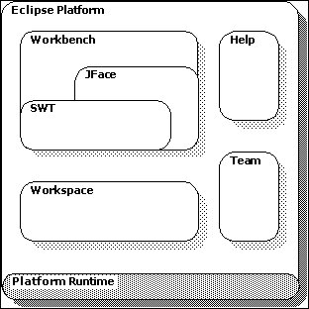
Overview of Eclipse
Eclipse
IDE: not only Java but C/C++…
Contributed by IBM at 2001
Managed by Eclipse Foundation
Open sourced
Cross-platform supported
Written in Java

Slide 4
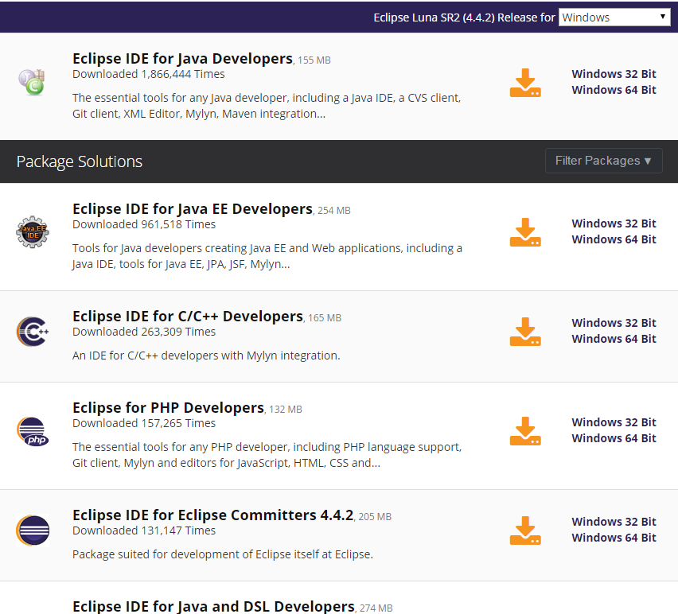
Overview of Eclipse
Get and Install
Download: http://www.eclipse.org/downloads/
Required Environment: JRE or JDK
Install: Unzip
Run: Such as eclipse.exe on Windows

Slide 5
Overview of Eclipse Plug-ins
Eclipse Plug-ins
Everything in Eclipse is a plug-in
A bundle manifest file, MANIFEST.MF.
A plug-in manifest file, plugin.xml
Code, documentation, resource bundles and others.

Slide 6
Overview of Eclipse Plug-ins
Eclipse Plug-ins Tools
Java Development Tools (JDT)
Web Tools Platform (WTP)
PHP Development Tools (PDT)
Android Development Tools (ADT)

Slide 7
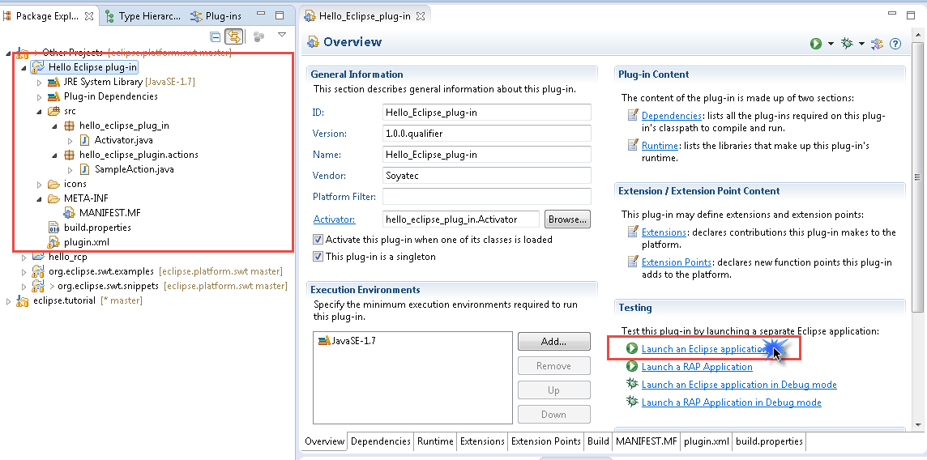
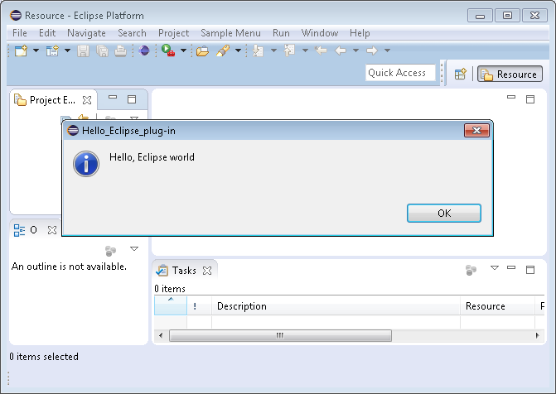
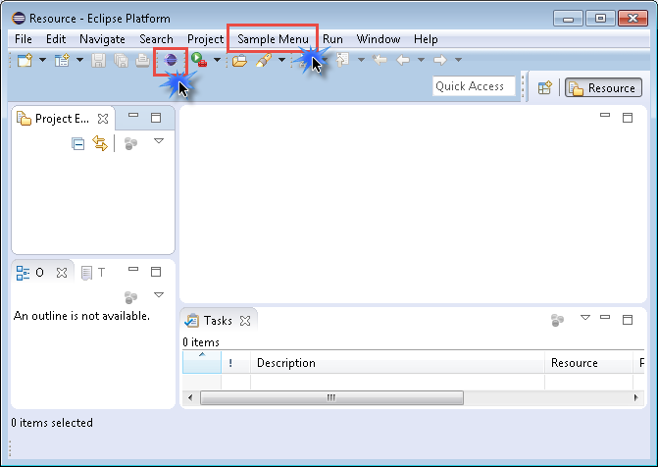
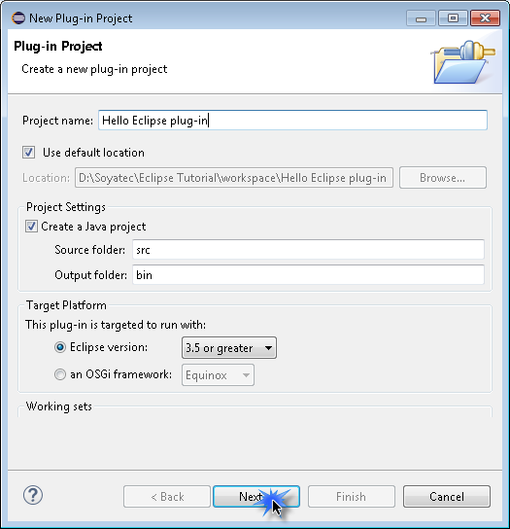
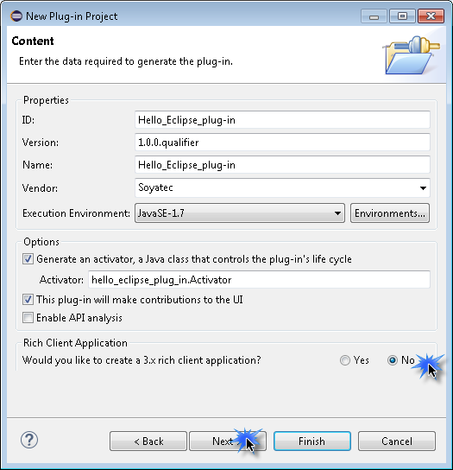
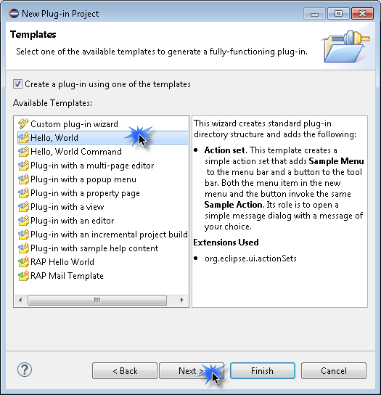
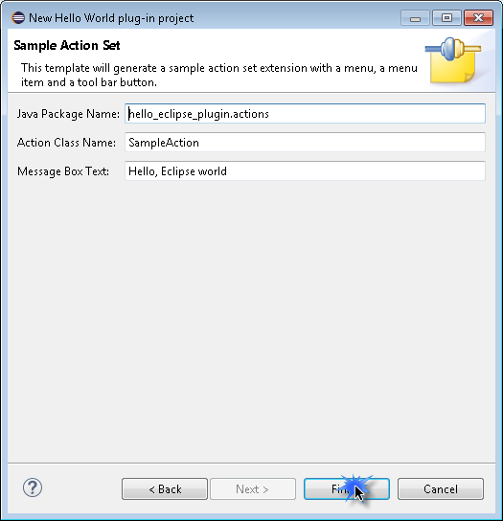
Overview of Eclipse Plug-ins
Eclipse Plug-ins Sample

Slide 8
Overview of Eclipse RCP
Eclipse RCP
Rich Client Platform
Based on a dynamic plug-in model
Same toolkits and extension points with Eclipse
Minimum requires:
org.eclipse.ui
org.eclipse.core.runtime

Slide 9
Overview of Eclipse RCP
Eclipse RCP Tools
IBM Notes 8 and 9
Novell/NetIQ Designer for Identity Manager
Apache Directory Studio
Remote Component Environment

Slide 10
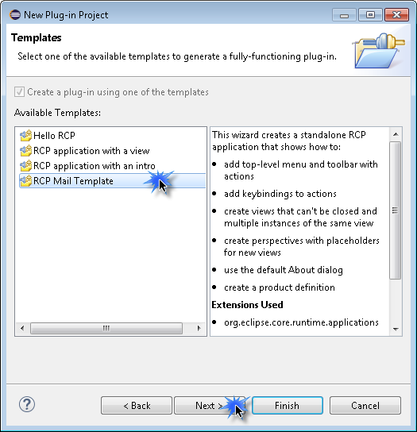
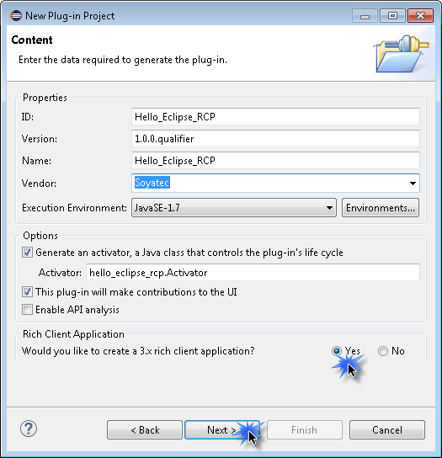
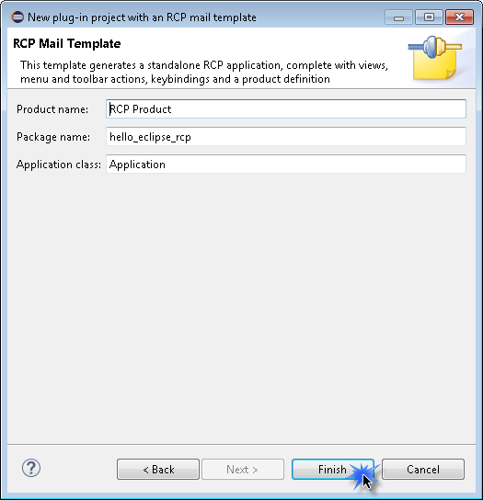
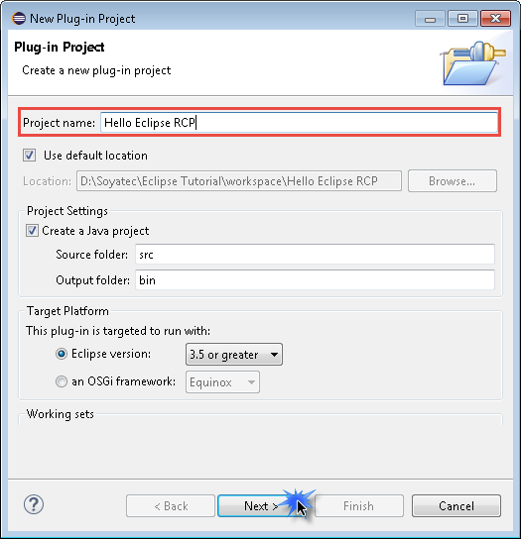
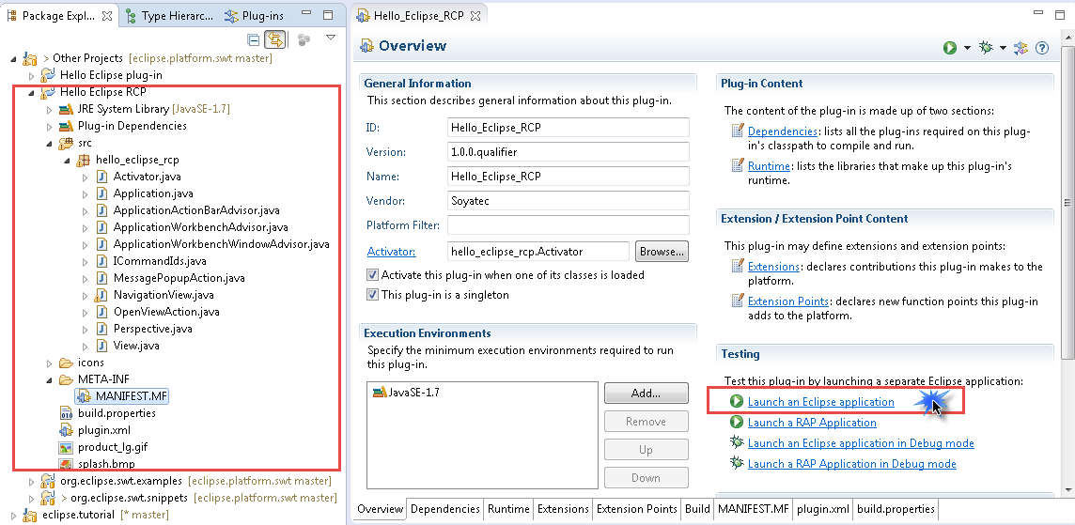
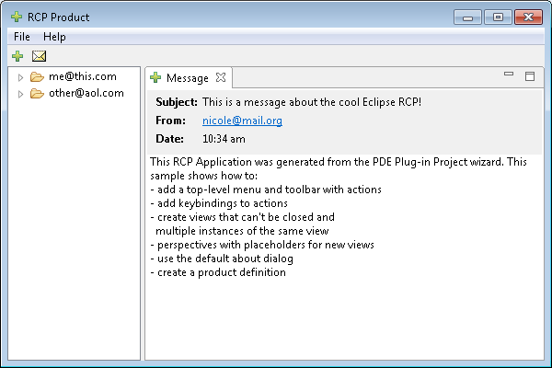
Overview of Eclipse RCP
Eclipse RCP Sample

Slide 11
Eclipse Workbench
Eclipse Workbench
Window
Menu Bar
Tool Bar
Shortcut Bar
Views
Editors
Status Line

Slide 12
Overview of SWT & JFace
SWT
Standard Widget Toolkits
Looking under the hood
Uses the platform's native widgets through JNI
UI Thread
JFace
Increase the library of SWT
Managing resources like image, font and color
Differences between Java GUI and SWT
Swing: Look and Feel, Thread
JavaFX: younger

Slide 13
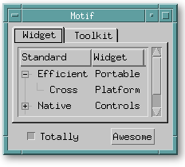
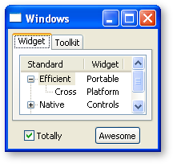
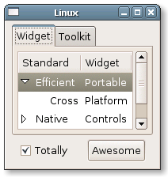
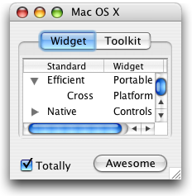
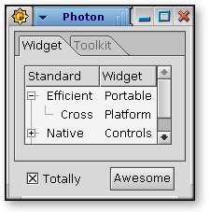
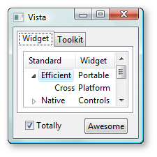
Overview of SWT & JFace
SWT/JFace Preview

Slide 14
Overview of SWT & JFace
SWT/JFace Sample

Slide 15
Overview of SWT & JFace

Slide 16
Overview of SWT & JFace
Display
Connect SWT and underlying operating system
One instance active
UI Thread
Event loop
Manually Disposed
Shell
Window: open, close, resize…
Component: containing children
Control: size, location…
Display display = new Display();
Shell shell = new Shell(display);
shell.setText("Hello SWT/JFace");
shell.setSize(300, 200);
shell.open();
while (!shell.isDisposed()) {
if (!display.readAndDispatch()) {
display.sleep();
}
}
display.dispose();

Slide 17
Overview of SWT & JFace
Control
Initialize: parent and style bits
Add to parent: finished when initialize
Bounds: must be assigned
Manually Disposed: dispose parent dispose children
In package:
org.eclipse.swt.widgets
org.eclipse.swt.custom
Super class
Widget
Control
// Add a button here
Button button = new Button(shell, SWT.PUSH);
button.setText("Click me");
button.setBounds(10, 10, 50, 30);

Slide 18
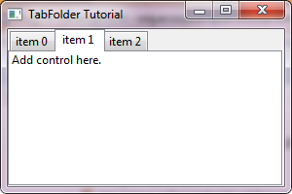
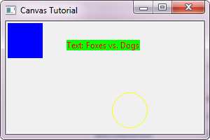
Overview of SWT & JFace
Component
Control which is capable of containing other controls
Layout
Client area
Super class
Composite
Special Components
Shell
TabFolder
Canvas

Slide 19
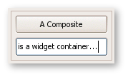
Overview of SWT & JFace
Widgets Snapshots
Browser
Button
Canvas
Combo
Composite

Slide 20
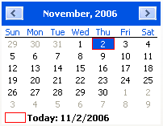
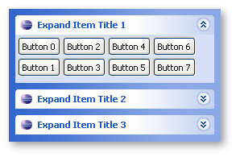
Overview of SWT & JFace
Widgets Snapshots
CoolBar
CTabFolder
DateTime
ExpandBar
Group

Slide 21
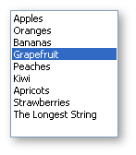
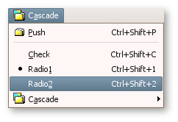
Overview of SWT & JFace
Widgets Snapshots
Label
Link
List
Menu
ProgressBar

Slide 22
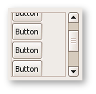
Overview of SWT & JFace
Widgets Snapshots
Sash
ScrolledComposite
Shell
Slider
Scale

Slide 23
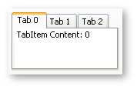
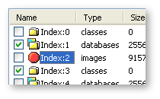
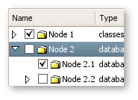
Overview of SWT & JFace
Widgets Snapshots
Spinner
StyledText
TabFloder
Table
Text
ToolBar
Tray
Tree

Slide 24
Any Questions?
Skype: jin.liu.soyatec
Email: jin.liu@soyatec.com

Slide 25
The end

